Slide 1
Supervised Learning project
Wendy Navarrete October 2019

Slide 2
CONTENT
Introduction
Information of Data
Attributes
Business Question
The Process
Results
Practical Uses
Opportunities to improve
Q&A

Slide 3

Introduction
This document contains the development and findings of a Data Science Project, which objective is to predict the popularity of articles published by Mashable website.

Slide 4
Information of data
This dataset summarizes a set of features about articles published by Mashable in a period of two years. The goal is to predict the popularity.
It came from UCI Machine Learning Repository website
It was obtained by downloading a csv file from website mentioned above
Dataset description
Number of Attributes | Attributes Characteristics | Number of Instances | Missing Values? | Outliers?
61 | Numeric and text | 39797 | No | Many

Slide 5
Attributes
WORDS: Number of words in title and content
LINKS: Number of links
INFORMATIVE: URL
TIME: Posting days (weekdays and weekend)
KEYWORDS: Best, worst, average keywords
MEDIA: Number of images and videos
LANGUAGE: Content and title sentiment polarity; positive or negative words in content

Slide 6
ATTRIBUTE DETAILS
Attribute | Type (#)
WORDS
Number of words in the title and content | numeric (2)
Average word length | numeric (1)
Rate of unique, non-stop and unique non-stop word | ratio (3)
Average length of the words in the content | numeric (1)
LINKS
Number of links | numeric (1)
Minimum, maximum and average of shares of referenced articles in Mashable | numeric (3)
Number of links to other articles published by Mashable | numeric (1)
Attribute | Type (#)
KEYWORDS
Average, worst and best keywords (min, max and avg.) | numeric (9)
Number of keywords | numeric (1)
Channel category (Lifestyle, entertainment, business, tech, social media and word) | boolean (6)
MEDIA
Number of videos and images | numeric (2)
INFORMATIVE
Article URL | string (1)
Days between the article publication and the dataset acquisition | numeric (1)

Slide 7
ATTRIBUTE DETAILS
Attribute | Type (#)
LANGUAGE PROCESSING
Content subjectivity and sentimental polarity | ratio (2)
Rate of positive and negative words in the content | ratio (2)
Rate of positive words among non-neutral tokens | ratio (2)
Polarity of positive and negative words (min, max and avg.) | ratio (6)
Title subjectivity and sentimental polarity | ratio (2)
Title subjectivity and polarity absolute levels | ratio (2)
Closeness to LDA topics (0-5) | ratio (5)
TIME
Posting day (Monday to Sunday and Weekends) | boolean (8)
Attribute | Type (#)
TARGET
Number of article shares | numeric (1)

Slide 8
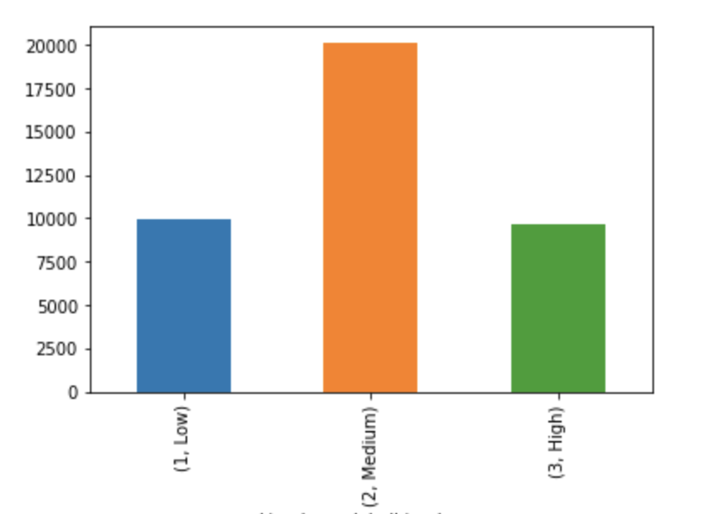
How popular is an article published by Mashable website?
Low
Medium
High

Slide 9
The Process
Data Extraction
Data Cleaning
Missing Values
Outliers
Data Exploration
Target Classification
Feature Analysis
Modeling
Feature Selection
Class Balance
Model Selection
Evaluate Predictions
Model Tuning

Slide 10
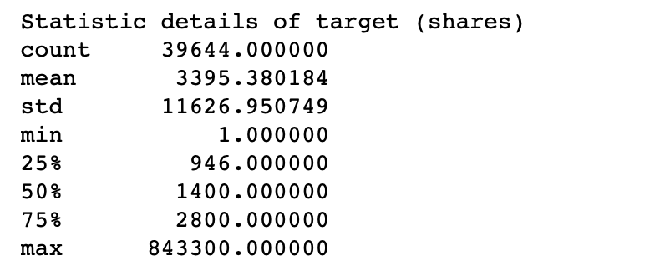
The Process
Data Exploration
Target Classification

Slide 11
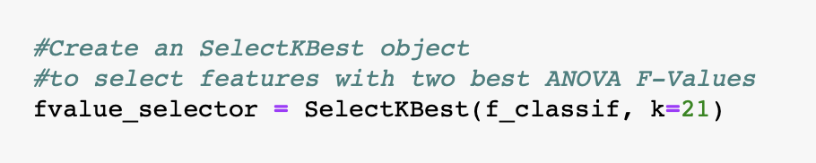
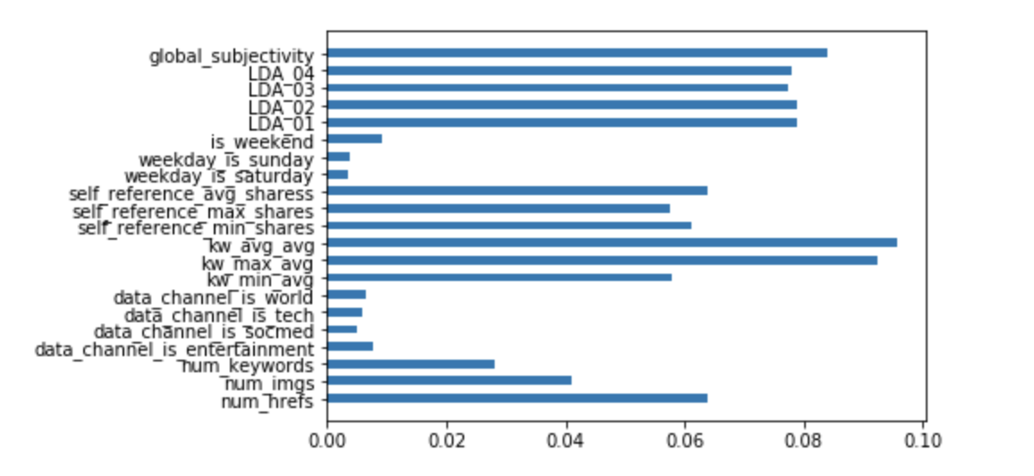
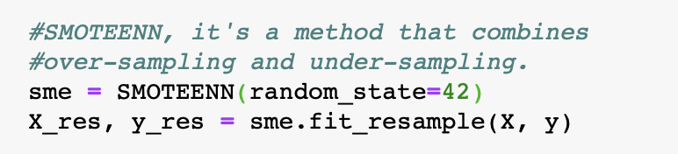
The Process
Feature Analysis
Feature Selection
Class Balance
SelectKBest Technique for Feature Selection
Check feature importance using Random Forest

Slide 12
The Process
Classification Models:
Random Forest
Support Vector Classification
KNN / K-Nearest Neighbor
Evaluate predictions:
Training accuracy score vs Test accuracy score
Model Tuning:
Grid Search
Modeling
Model Selection
Evaluate Predictions
Model Tuning

Slide 13
results
Model | Training Set Accuracy Score | Test Set Accuracy Score
Random Forest | 1.0000 | 0.80470
SVC | 1.0000 | 0.62370
KNN | 0.8261 | 0.75512
Overall, the best result was achieved by a K-nearest neighbor (KNN), with a 75.51% of accuracy on predictions

Slide 14
practical uses
Because this model objective is to predict the level of popularity of articles based on number of shares, this model can be applied basically in most of the websites which interest to share their own content
Some examples:
Blogs sites
Newspaper sites
Magazine sites

Slide 15

Opportunities to improve
This model was compared with just two other models
Two of those models presented overfitting. After applied different techniques of regularization, overfitting is still there
Because the range of numbers of shares is very large, the target bins might result in more than three classes and get more precise results

Slide 16
Q & A

Slide 17
THANKS
Wendy Navarrete
navarrete.wen@gmail.com

